Slide 1
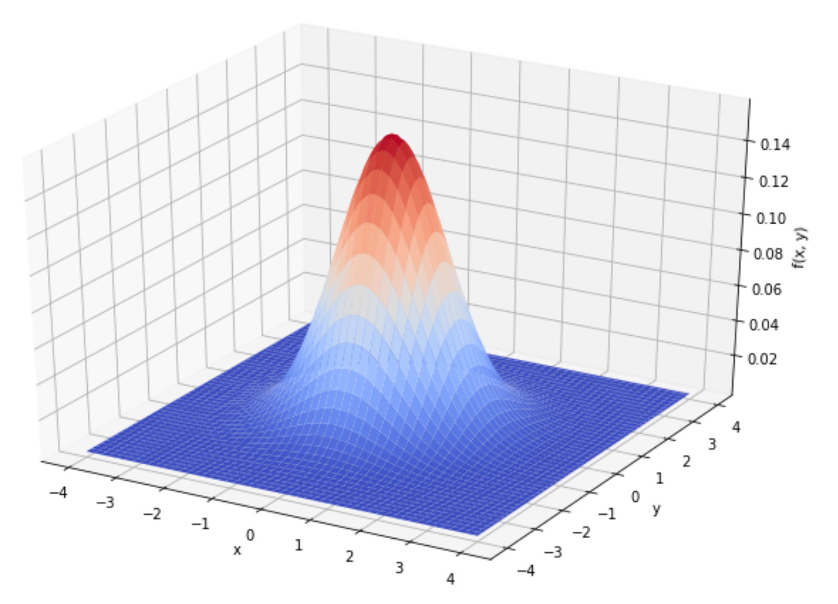
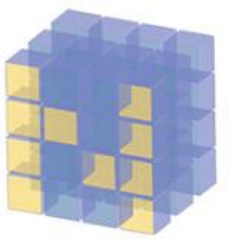
How to plot 2d Standard Normal PDF

Slide 2
Reference
Youtube
Code

Slide 3
np.meshgrid

Slide 4
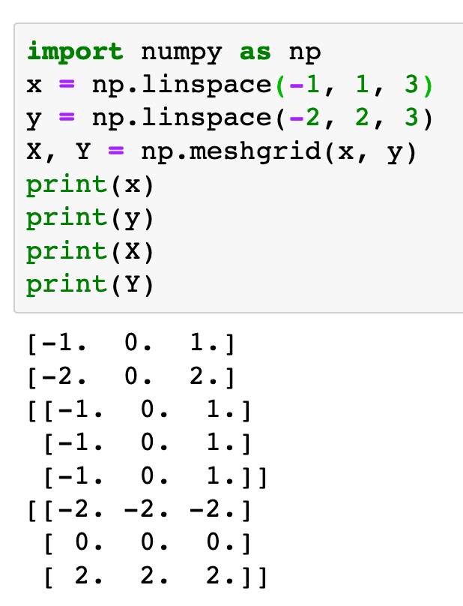
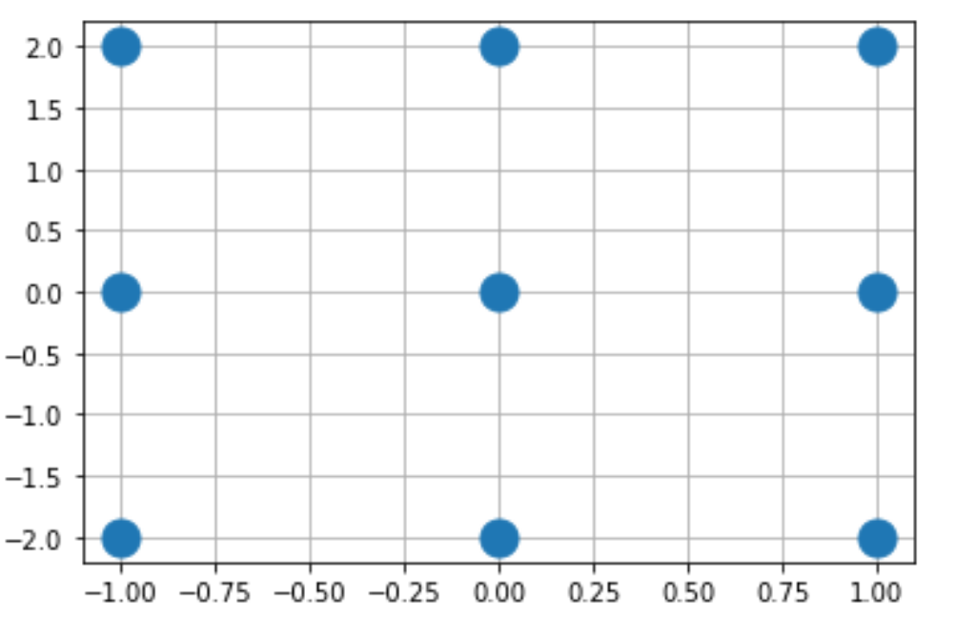

Slide 5
np.meshgrid

Slide 6
2d Standard Normal PDF

Slide 7
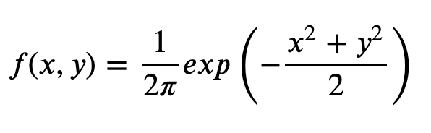

Slide 8
How to plot 2d Standard Normal PDF

Slide 9
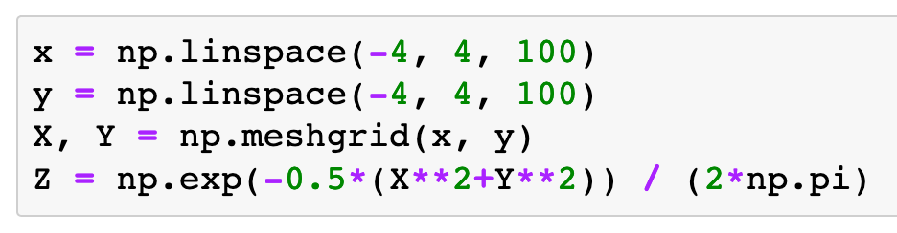

Slide 10
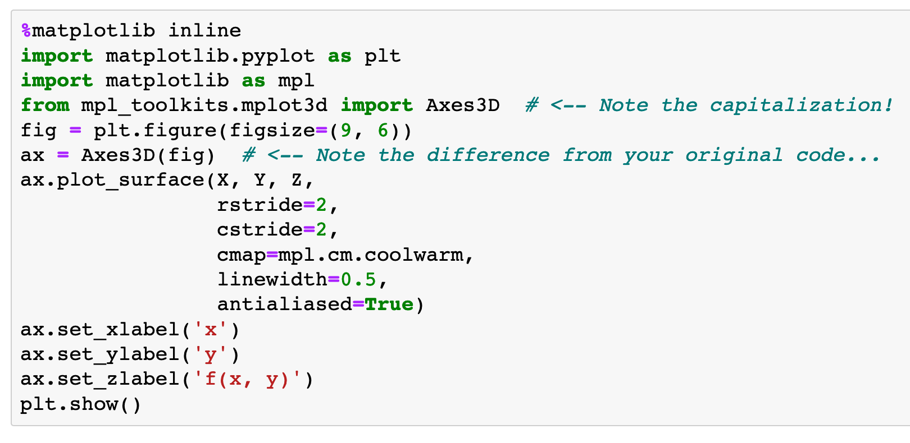

Slide 11
make figure object
make figure object

Slide 12
make 3d axes
make 3d axes

Slide 13
plot_surface

Slide 14
matrices

Slide 15
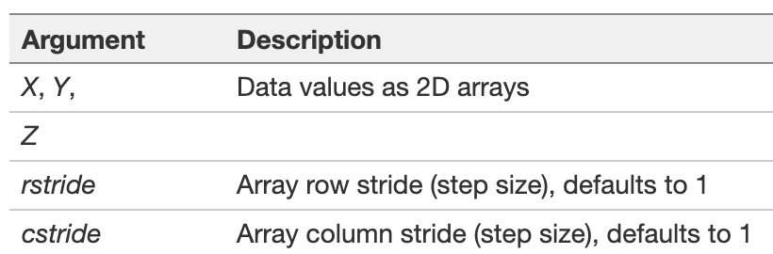

Slide 16
colormap
colormap

Slide 17
stakoverflow
wiki

Slide 18
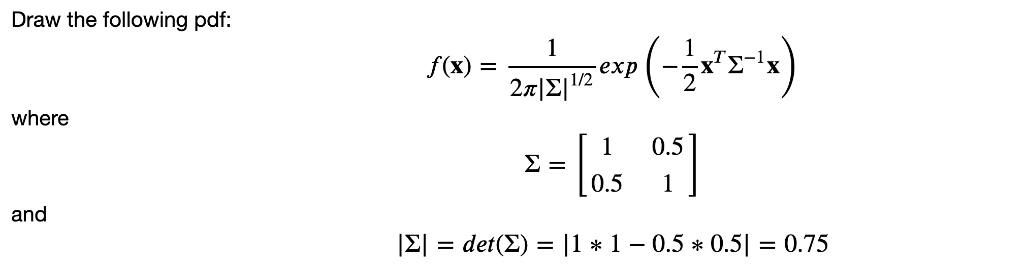
Exercise

Slide 19

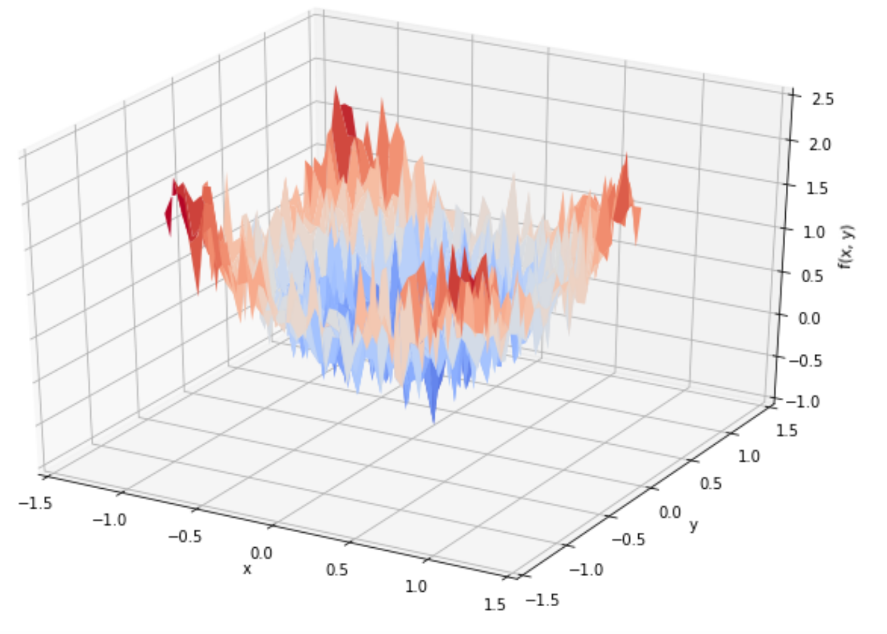
Exercise

Slide 20
Now
Let’s Play with Code

